Slide 1
Class 1
The State of Play in International Trade and Trade Policy I:
Trade Wars by
Alan V. Deardorff
University of Michigan
2021
PubPol/Econ 541

Slide 2
Announcements
I mis-spoke on Tuesday when I said you could turn in quizzes late (for a penalty) any time until Sunday midnight. This should have been Saturday midnight.
Next Tuesday I’ll start by asking you for News, then discuss what I’ve noticed myself.

Slide 3
Plan for Course
Recent trade events (trade war, etc.)
Tariff/quota analysis (needed for papers)
Int’l macro (exchange rates, deficit)
Institutions (Int’l, national)
Trade barriers (NTBs)
Trade theory (General equilibrium)
Uses & abuses (FTAs, remedies)

Slide 4
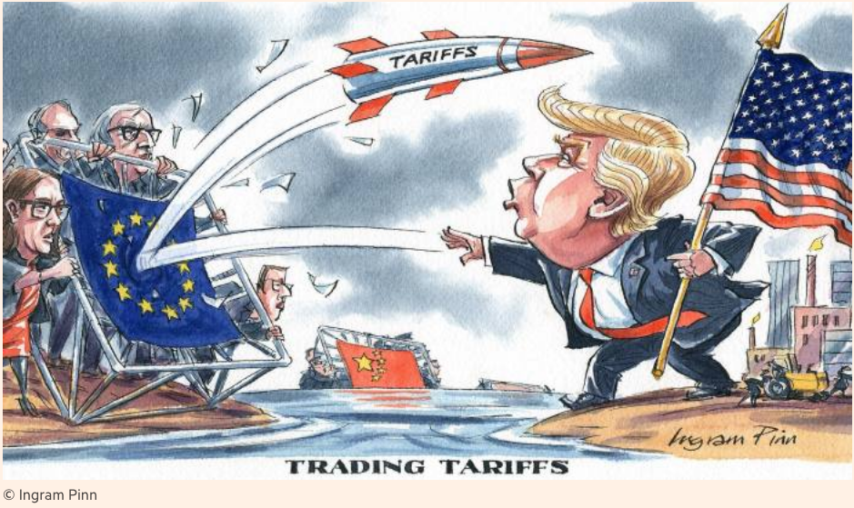
Notes:
Pinn, Ingram, “Ingram Pinn’s illustration of the week: Trading tariffs,” Financial Times, June 22, 2018.
https://www.ft.com/content/c56ebb64-7579-11e8-b326-75a27d27ea5f

Slide 5
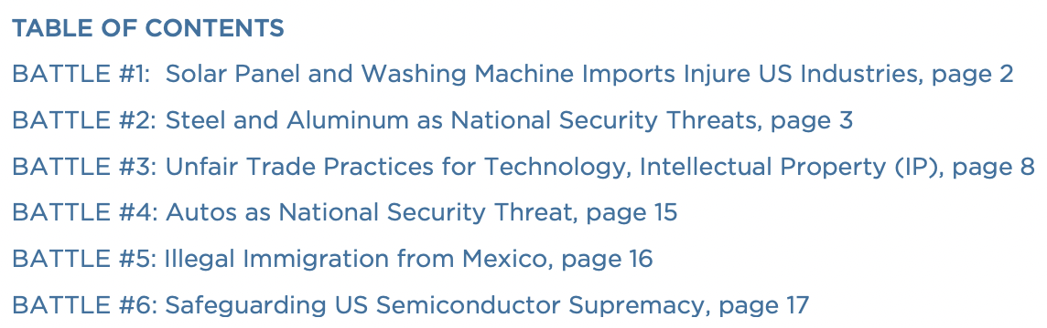
Bown, Chad P. and Melina Kolb, "Trump's Trade War Timeline
We’ll focus on these two only
Notes:
Pinn, Ingram, “Ingram Pinn’s illustration of the week: Trading tariffs,” Financial Times, June 22, 2018.
https://www.ft.com/content/c56ebb64-7579-11e8-b326-75a27d27ea5f

Slide 6
Pause for Discussion

Slide 7
  Questions on Bown & Kolb
With what countries is the US engaged in a trade war?
What have been the legal bases (within the US) for tariffs and threats of tariffs?
What is the current status of the trade war with China?
To what extent has President Biden reversed the tariffs begun by Trump?

Slide 8
Trade Wars, 2018-2020
Outline
  Battles in the Trade Wars
    (Washing Machines & Solar Panels)
    Steel & Aluminum
    Intellectual Property / US-China Trade War
    (Cars)
    (Mexico migration)
    Targeting Companies
  Effects of the Trade Wars

Slide 9
  Steel & Aluminum
National Security
  Section 232 of US trade law
  Tariffs on imports that “threaten national security”
  “National security” is not defined
  Legality in WTO is unclear

Slide 10
  Steel & Aluminum
National Security
  Mar 1, 2018: Trump levies tariffs
    25% on steel, 10% on aluminum
    Against all countries
      Several removed shortly thereafter
      Remained in place on EU, China, Canada, Mexico, and others
    Retaliation by all
    (Tariffs on Canada & Mexico later removed, then reinstated on Canadian aluminum Aug 6, 2020)

Slide 11
  Steel & Aluminum
US-EU Negotiations
  Talking now about removing the US tariff and EU’s retaliatory tariffs
  Result, according to EU Trade chief:
    “may fall short of removing all the barriers sheltering the industries”
  Why”
    “We understand the willingness of the US to protect its steel industry, but certainly there are ways to do it in a way which is less disruptive for EU producers”
  Talks are on a “constructive track”

Slide 12

Valdis Dombrovskis said any solution to the dispute would have to be less disruptive to EU producers and respect historical volumes of trade

Slide 13
Pause for Discussion

Slide 14
  Questions
Why doesn’t Biden just remove the Trump tariffs on steel and aluminum?
As of this date (of the Barfield reading), had the WTO ruled on any national-security-based trade restrictions?
Does the Biden administration accept that the WTO has the power to judge the legitimacy of a country’s use of national-security-based trade restrictions?

Slide 15
  US-China Trade War
Based mostly on intellectual property
  IP mostly includes patents, trademarks, copyrights, and trade secrets
  US (and others) claim that China
    Steals technology secrets
    Forces investors to turn over technologies in joint ventures

Slide 16
  US-China Trade War
USTR (United States Trade Representative) under Trump
  Initiated investigation of China’s IP practices
  Under Section 301 of US trade law – Unfair trade practices
  This is not something permitted by the WTO

Slide 17
  US-China Trade War
March 22, 2018: Report found unfair trade practices
  IP violations (see above)
  Also subsidies to firms and state-owned enterprises (SOEs) to trade unfairly
Trump announced tariffs on up to $60 billion of China’s exports to US

Slide 18
  US-China Trade War
US and China levied tariffs on each other
  Three times in 2018, twice in 2019
    Trump either added new tariffs on China exports or raised them
    Each time, China responded with tariff on US exports
  Threat of more in December 2019 was suspended by the “Phase One” US-China Trade Deal

Slide 19
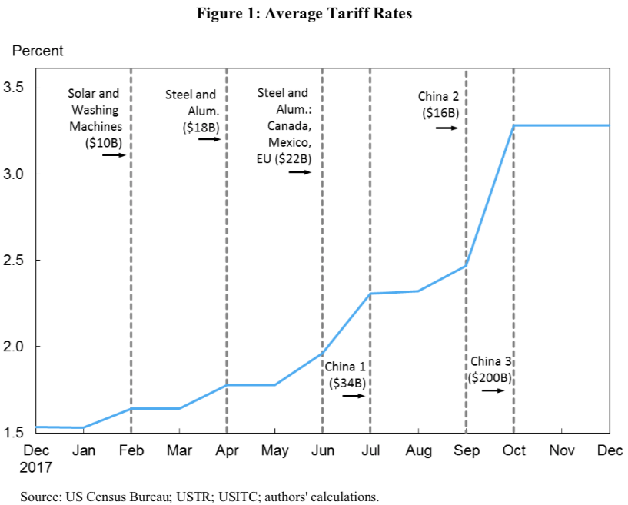
Trump Tariffs, 2018
Source: Amiti, et al. 2019.

Slide 20
  US-China Trade War
Phase One Deal
  In anticipation, Trump called off December 2019 tariffs
  Agreement signed January 15, 2020
Content of Deal:
  China to buy $200 billion more US exports
  US to reduce a few tariffs on China
  China to stop forcing foreign companies to transfer technology
  Most tariffs remain in place by both, and China did not address subsidies and SOEs

Slide 21
  US-China Trade War
Phase One Deal as of today (Bradsher)
  Pandemic hit trade hard and slowed China’s imports
  Did not remove China’s subsidies. Instead US continued tariffs on subsidized imports
  This is setting a pattern that others (EU) may follow
  Deal has not reduced the US trade deficit with China

Slide 22
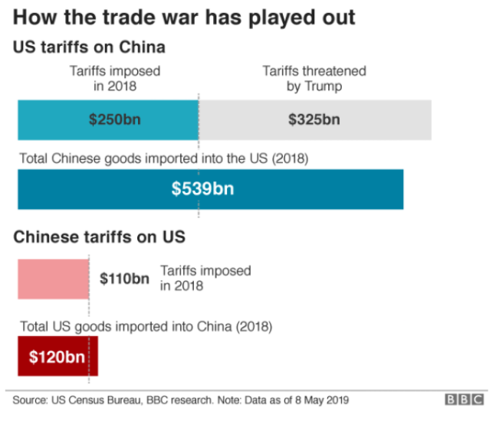
Notes:
Palumbo, Daniele and Ana Nicolaci da Costa, “Trade war: US-China trade battle in charts,” BBC News, May 10, 2019.

Slide 23
  US-China Trade War
Actions by US under Biden & USTR Tai
(Davis & Hayashi)
  Nothing yet
  US will not simply remove the tariffs
    Even though “tariffs can exact a toll on U.S. businesses and consumers “
  Why not? The China tariffs
    “Shield companies from subsidized foreign competition”
    Give USTR “leverage”

Slide 24
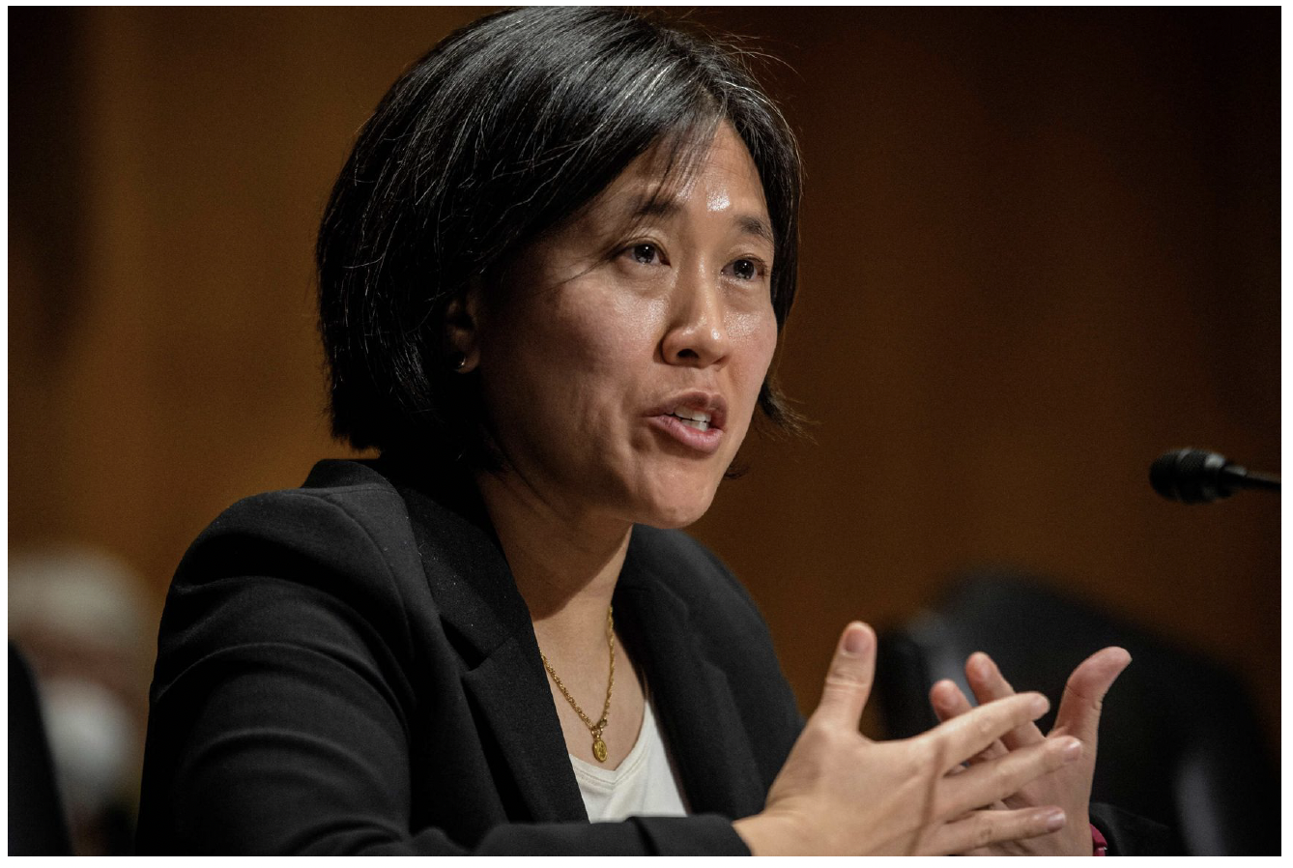
Katherine Tai comes to the trade job with striking bipartisan support—including a 98-0 confirmation vote by the Senate.

Slide 25
Pause for Discussion

Slide 26
  Questions on Bradsher
Did the Phase One deal remove China’s subsidies and US tariffs?
What pattern did the Phase One deal set that others are following?
Will Phase One be followed by Phase Two?
In what ways does China provide subsidies?

Slide 27
  Questions on Davis & Hayashi
Which country (China or US) put tariffs on more of the other’s exports?
Is China on track to increase imports by the amount promised?
What effects of the tariffs are mentioned here?
Why, under Biden, hasn’t the US just removed the tariffs on China?

Slide 28
  Targeting Chinese Companies
US Entity List
  “A tool utilized by BIS to restrict the export, reexport, and transfer (in-country) of items … reasonably believed to be … contrary to the national security or foreign policy interests of the United States.”
    Department of Commerce, Bureau of Industry and Security (BIS)
  List has many entities from many countries (474 pages of them)
  Exports are not necessarily banned, but require a license
Notes:
https://www.commerce.gov/news/press-releases/2021/07/commerce-department-adds-34-entities-entity-list-target-enablers-chinas
https://www.bis.doc.gov/index.php/documents/regulations-docs/2326-supplement-no-4-to-part-744-entity-list-4/file

Slide 29
  Targeting Chinese Companies
US Entity List (cont.)
  Recently expanded the number of Chinese companies on the list
    Trump added “dozens of Chinese companies”
    Biden added firms building supercomputers
      See Sevastopulo
Notes:
https://www.commerce.gov/news/press-releases/2021/07/commerce-department-adds-34-entities-entity-list-target-enablers-chinas

Slide 30
  Targeting Chinese Companies
Trump and Biden have also banned investment in some Chinese companies
  Trump has banned investment in 48 companies
  Biden increased that to 59 as of June 3
    See Lubold & Leary
  Based on links to China’s military
  Current investors have 1 year to divest
Notes:
https://www.commerce.gov/news/press-releases/2021/07/commerce-department-adds-34-entities-entity-list-target-enablers-chinas

Slide 31
  Targeting Chinese Companies
Trump used national security as the grounds for a series of actions against Chinese companies
  ZTE
  Huawei
  TikTok

Slide 32
  Targeting Chinese Companies
ZTE
  In 2018 Trump banned US firms from selling products to ZTE,
    a major Chinese maker of telecoms equipment,
    concerned that it would let Beijing spy on the US
  After several months and reversals of the policy, ZTE was allowed to continue.
    Trump used it as bargaining chip with President Xi
    ZTE “loaded up on lobbyists”
Notes:
Swanson & Vogel, “Faced With Crippling Sanctions, ZTE Loaded Up on Lobbyists,” New Hork Times, Aug 1, 2018.
https://www.nytimes.com/2018/08/01/us/politics/zte-sanctions-lobbying.html?rref=collection%2Fissuecollection%2Ftodays-new-york-times&action=click&contentCollection=todayspaper&region=rank&module=package&version=highlights&contentPlacement=5&pgtype=collection

Slide 33
  Targeting Chinese Companies
Huawei
  The world’s largest telecommunications equipment maker
  US worried that, although a private company, the Chinese government could use it to spy
  2012: US firms were encouraged not to buy from Huawei
  2018: US asked allies not to buy from Huawei, but few complied (New Zealand, UK)
Notes:
Swanson & Vogel, “Faced With Crippling Sanctions, ZTE Loaded Up on Lobbyists,” New Hork Times, Aug 1, 2018.
https://www.nytimes.com/2018/08/01/us/politics/zte-sanctions-lobbying.html?rref=collection%2Fissuecollection%2Ftodays-new-york-times&action=click&contentCollection=todayspaper&region=rank&module=package&version=highlights&contentPlacement=5&pgtype=collection

Slide 34
  Targeting Chinese Companies
Huawei (cont.)
  May 2019: US firms were banned from selling chips made in US to Huawei
  Aug 2020: US prohibited anyone from selling chips to Huawei, custom or not, if produced with American technology”
    Based on “foreign direct product rule” – stronger than entities list
  Governments in Africa, Asia, and Latin America are still buying from them
    See Kynge
    “77% of these countries are “not free” or “partly free” according to Freedom House.

Slide 35
  Targeting Chinese Companies
TikTok
  A very popular video app owned by the Chinese company ByteDance, was said by Trump to threaten national security
    By making data on its users available to the Chinese government
  Trump threatened to ban it but did not.

Slide 36
Pause for Discussion

Slide 37
  Questions
Does the US ban on investments in Chinese companies apply only to new investment?
Are there circumstances, aside from licensing, in which a US company can still sell to listed entities?
Has the US succeeded in persuading other governments not to deal with Huawei?

Slide 38
  Imports from Xinjiang, China
The concern (in US and EU)
  Human rights
    “Rights groups, researchers, former residents and some Western lawmakers and officials say Xinjiang authorities have facilitated forced labor by detaining around a million Uyghurs and other primarily Muslim minorities since 2016.” (Martina)

Slide 39
  Imports from Xinjiang, China
Previous actions
  US banned specific imports from Xinjiang:
    Tomatoes (January 2021)
    Cotton (January 2021)
    Some solar products (June 2021)
  French investigation into four fashion retailers
    (See Martina)

Slide 40
  Imports from Xinjiang, China
The new US policy
    See Martina
  US law has banned imports produced with forced labor since the Tariff Act of 1930
  New law likely to be enacted:
    Uyghur Forced Labor Prevention Act
    Creates “rebuttable presumption” that goods produced in Xinjiang use force labor

Slide 41
  Imports from Xinjiang, China
Private-sector actions
      See Lin et al.)
  Suppliers to several companies (Apple, Nike) are phasing out employment of “Uyghur factory workers transferred from Xinjiang through a state-backed labor program.”
  China’s response: “state-run transfers of Uyghur, Kazakh and other mostly Muslim minority laborers are part of poverty-alleviation programs”

Slide 42
Pause for Discussion

Slide 43
  Questions
What “advisory” did Biden issue relating to Xinjiang?
Is the new bill, the Uyghur Forced Labor Prevention Act, likely to become law?

Slide 44
  Effects of the Trade Wars
Best seen pre-pandemic
  Sectors that are hit
  Tariffs by and against China
  Trade with China
  US trade balance
  Stock markets

Slide 45
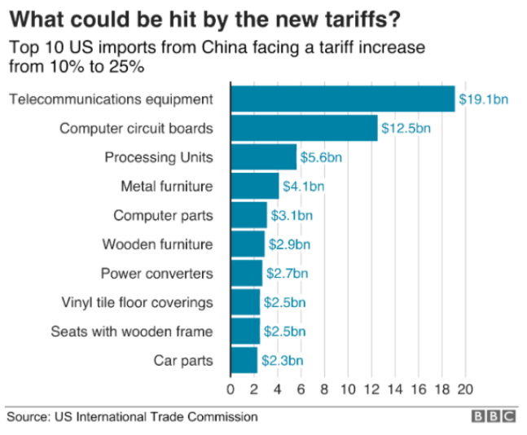
Notes:
Palumbo, Daniele and Ana Nicolaci da Costa, “Trade war: US-China trade battle in charts,” BBC News, May 10, 2019.

Slide 46
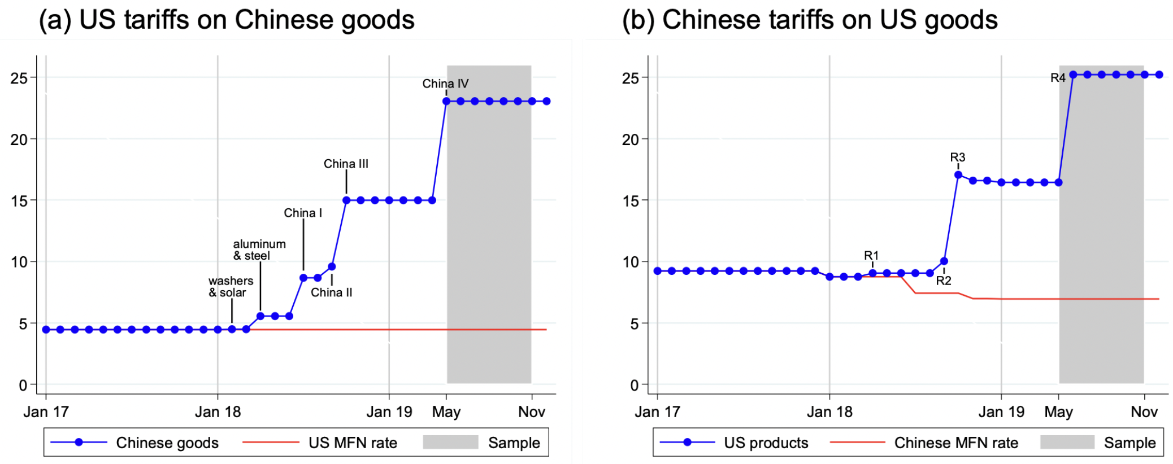
Source: He et al., July 2021
Notes:
“The effects of the US-China trade war on firms’ vacancy postings” Chuan He, Karsten Mau, Mingzhi (Jimmy) Xu 15, VOXEU, July 2021
https://voxeu.org/article/effects-us-china-trade-war-firms-vacancy-postings

Slide 47
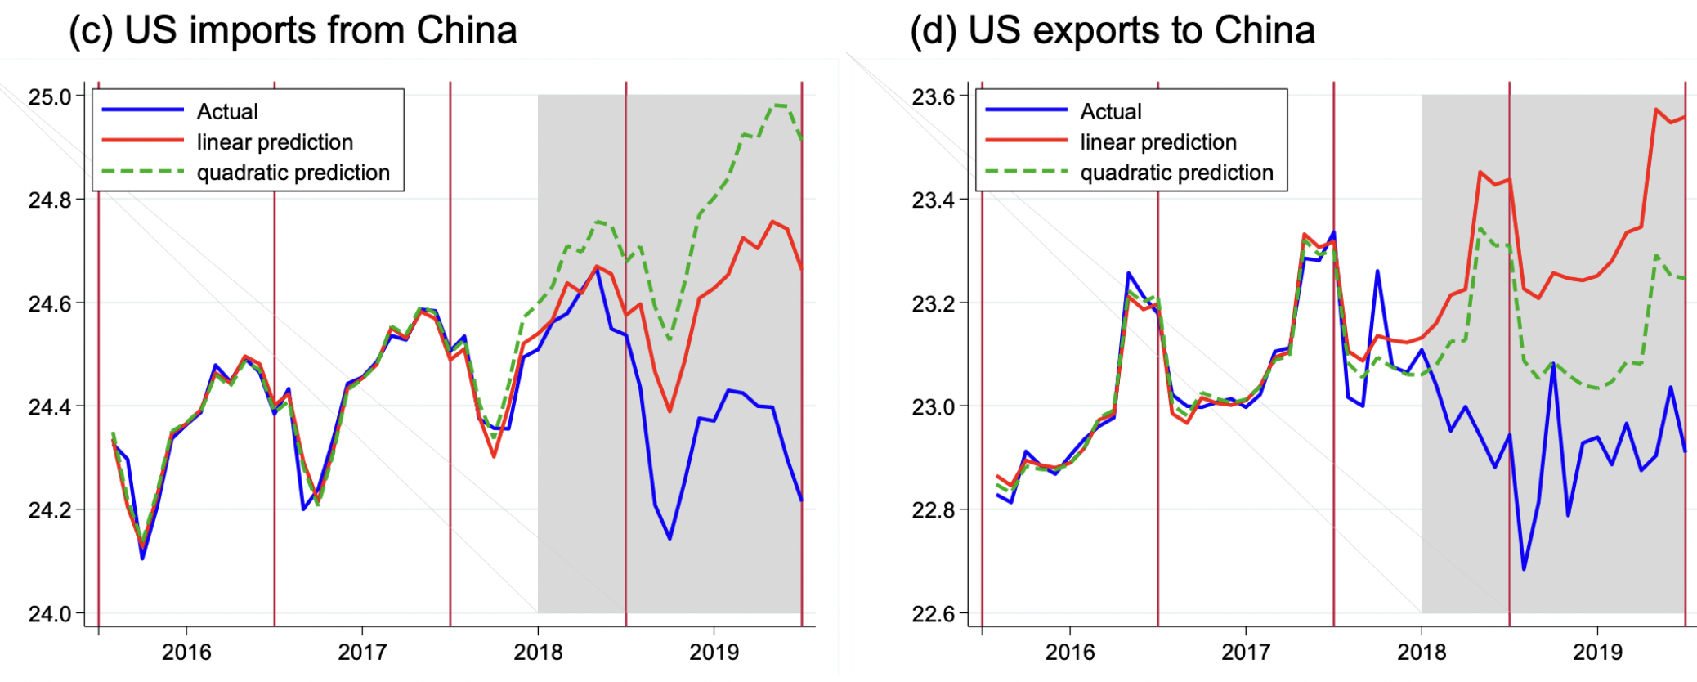
Source: He et al., July 2021
Notes:
“The effects of the US-China trade war on firms’ vacancy postings” Chuan He, Karsten Mau, Mingzhi (Jimmy) Xu 15, VOXEU, July 2021
https://voxeu.org/article/effects-us-china-trade-war-firms-vacancy-postings

Slide 48
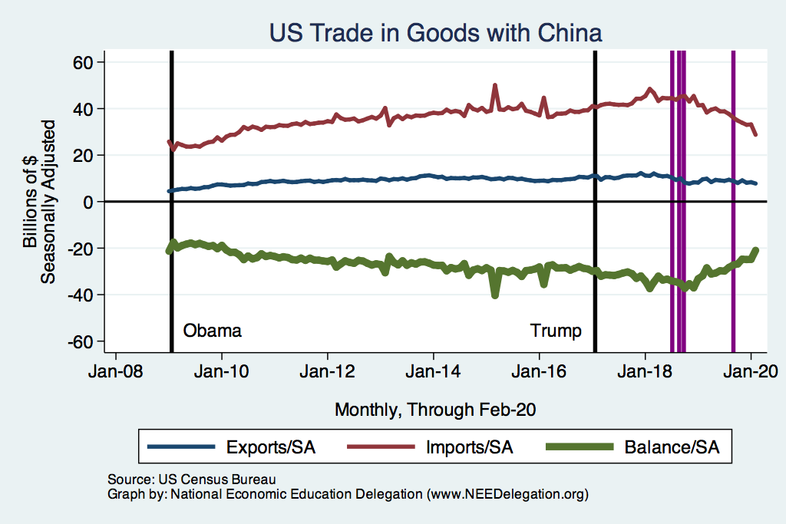
US Trade with China
Notes:
Presentations / NEED / Graphs202007

Slide 49
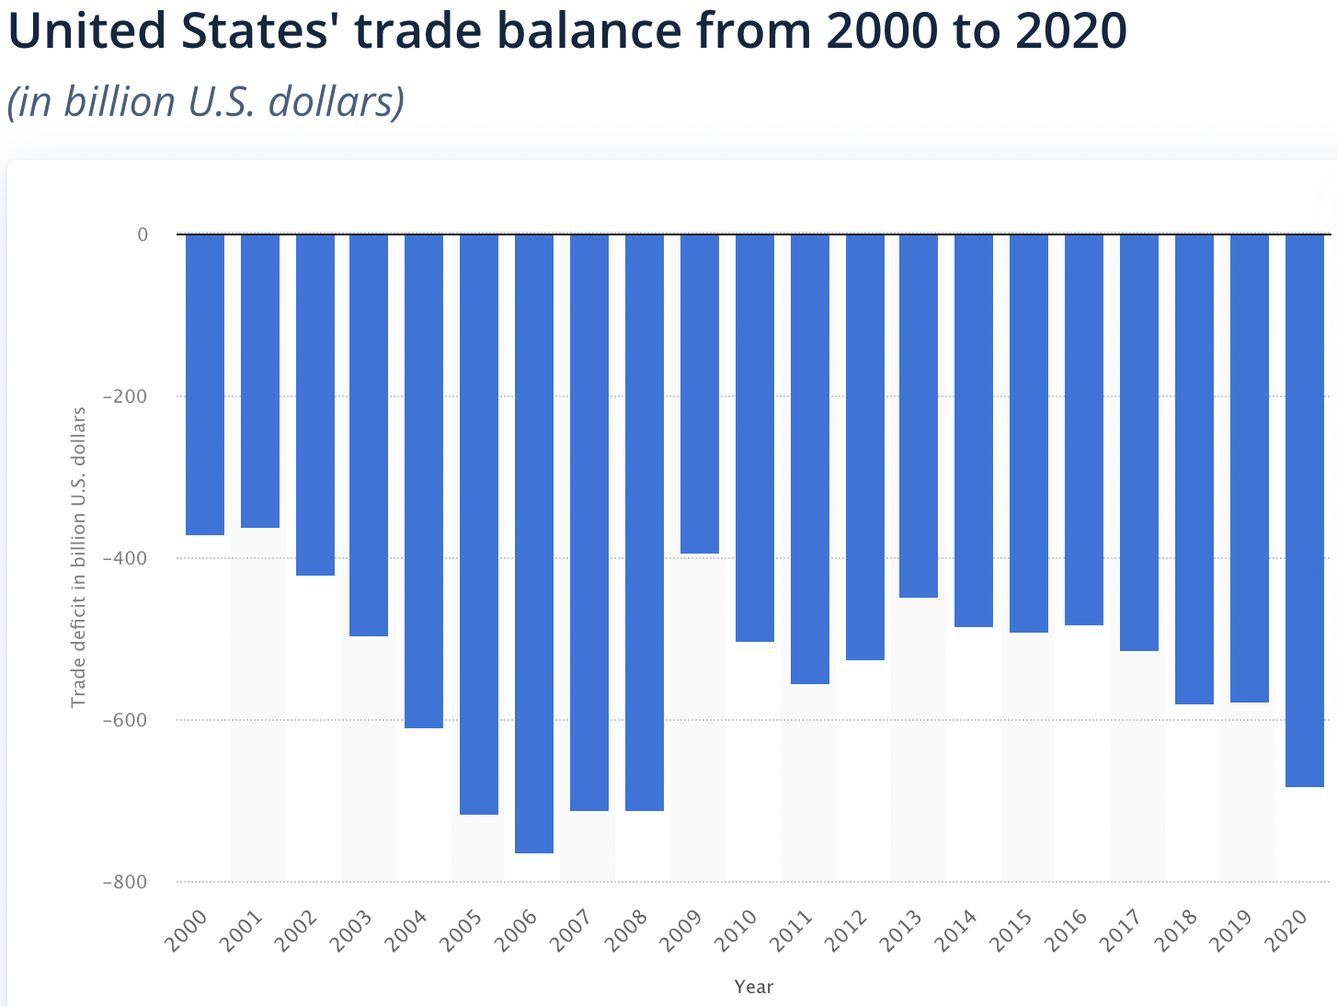
US Trade with World
Trade War
Source: Statista
Notes:
https://www.statista.com/statistics/220041/total-value-of-us-trade-balance-since-2000/

Slide 50
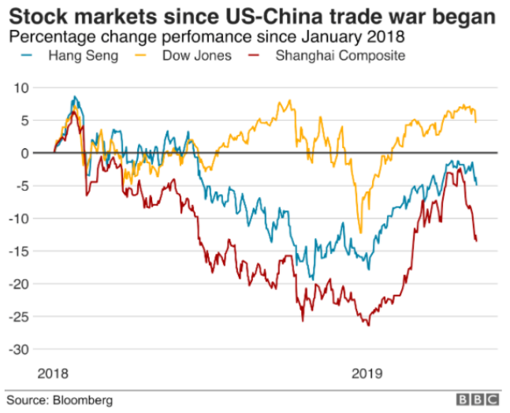
Notes:
Palumbo, Daniele and Ana Nicolaci da Costa, “Trade war: US-China trade battle in charts,” BBC News, May 10, 2019.

